Slide 1

MEDICAL DIAGNOSIS AIML Project
Supervised by:
Dr. Rajender Kumar
Submitted by:
Gurinder Singh : 2210990337
Gurkirat Singh : 2210990339
Gyan Biswal : 2210990354
Nikhil : 2210990608

Slide 2
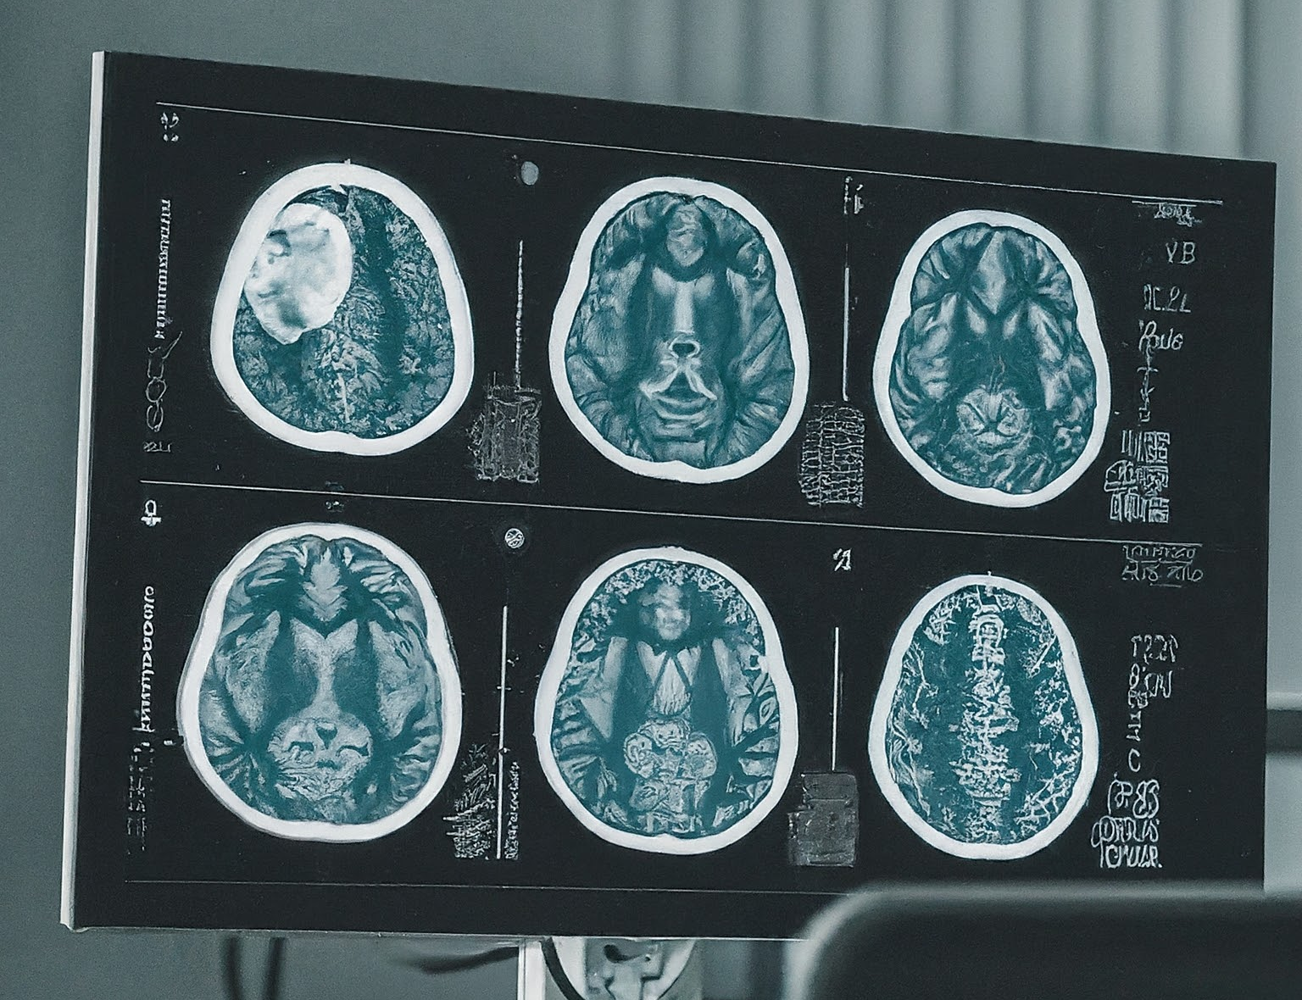
Revolutionizing Medical Diagnosis with AIML
In this presentation, we will explore the exciting potential of Artificial Intelligence (AI) in revolutionizing medical diagnosis. We will delve into how this technology can assist healthcare professionals, improve patient outcomes, and shape the future of medicine.

Slide 3
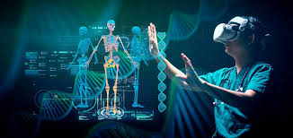
The Challenges of Traditional Diagnosis
•Limited access to specialists in remote areas
•Human error and subjectivity in decision-making
•Time constraints leading to rushed diagnoses
•Difficulty in interpreting complex medical data
Traditional medical diagnosis faces several challenges. Lack of specialist availability in remote areas can delay diagnosis and treatment. Human error and subjectivity can lead to misdiagnosis. Time constraints can prevent doctors from giving thorough examinations. Additionally, interpreting complex medical data can be overwhelming.

Slide 4
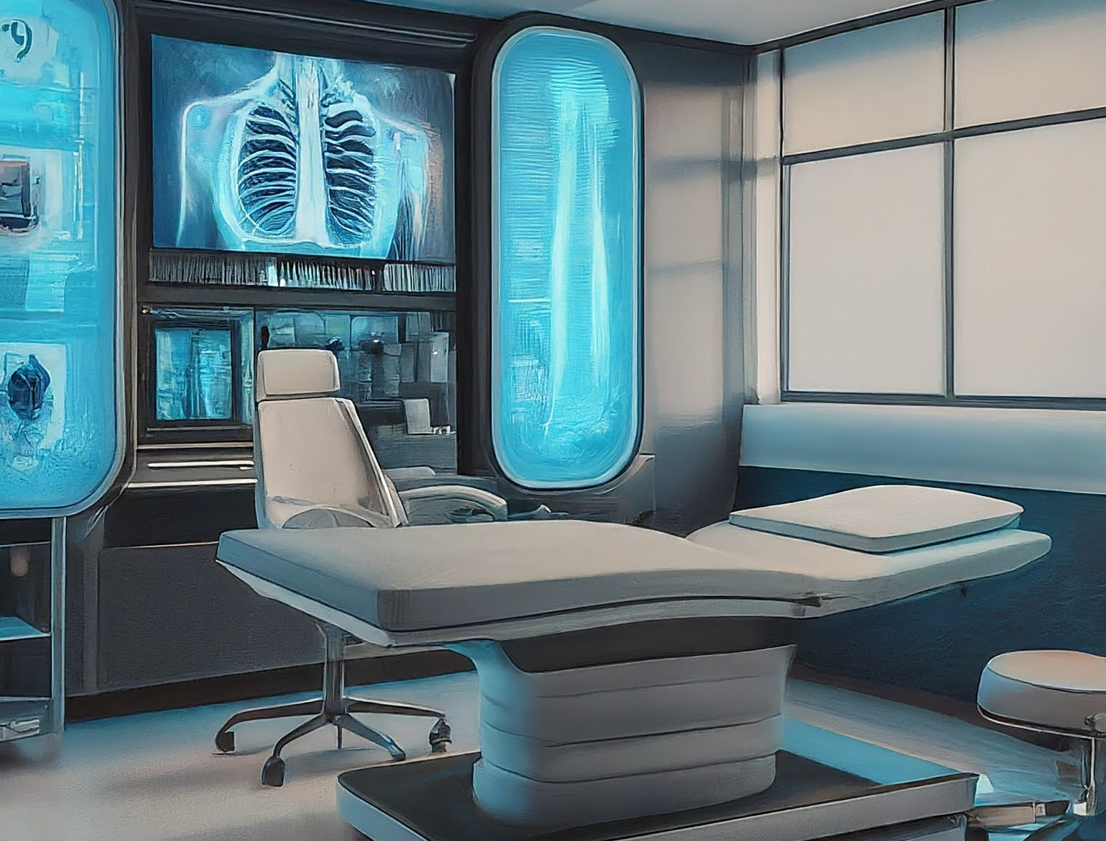
The Power of AI in Medical Diagnosis
Analyze large amounts of medical data (patient history, lab results, imaging scans)
Identify patterns and correlations missed by humans
Support doctors in differential diagnosis, suggesting potential causes of symptoms
Predict the likelihood of developing certain diseases

Slide 5
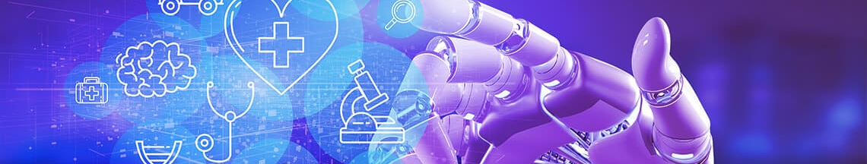
Introducing AIML: The Language of AI
AIML is a language for creating chatbots
Enables computers to understand and respond to human language
Allows for building interactive AI systems for medical diagnosis
Patients can interact with an AIML-powered system, providing symptoms and receiving initial guidance
AIML plays a crucial role in making AI accessible. AIML allows computers to understand and respond to human language. This enables the creation of interactive AI systems for medical diagnosis. Patients can interact with an AIML-powered system, providing symptoms and receiving initial guidance.

Slide 6
Our Project: An AIML-based Medical Diagnosis Assistant
Enhancing your presentationWe propose an AI-powered medical diagnosis assistant using AIML
User interface with a chatbot for patients to describe their symptoms
AIML engine to process user input and match it with known medical conditions
System suggests potential diagnoses and recommends consulting a doctor
Our project revolves around developing an AIML-based medical diagnosis assistant. This system will have a user-friendly chatbot interface where patients can describe their symptoms. The AIML engine will process user input and match it with known medical conditions. Based on the analysis, the system will suggest potential diagnoses and recommend consulting a doctor for a definitive diagnosis.

Slide 7
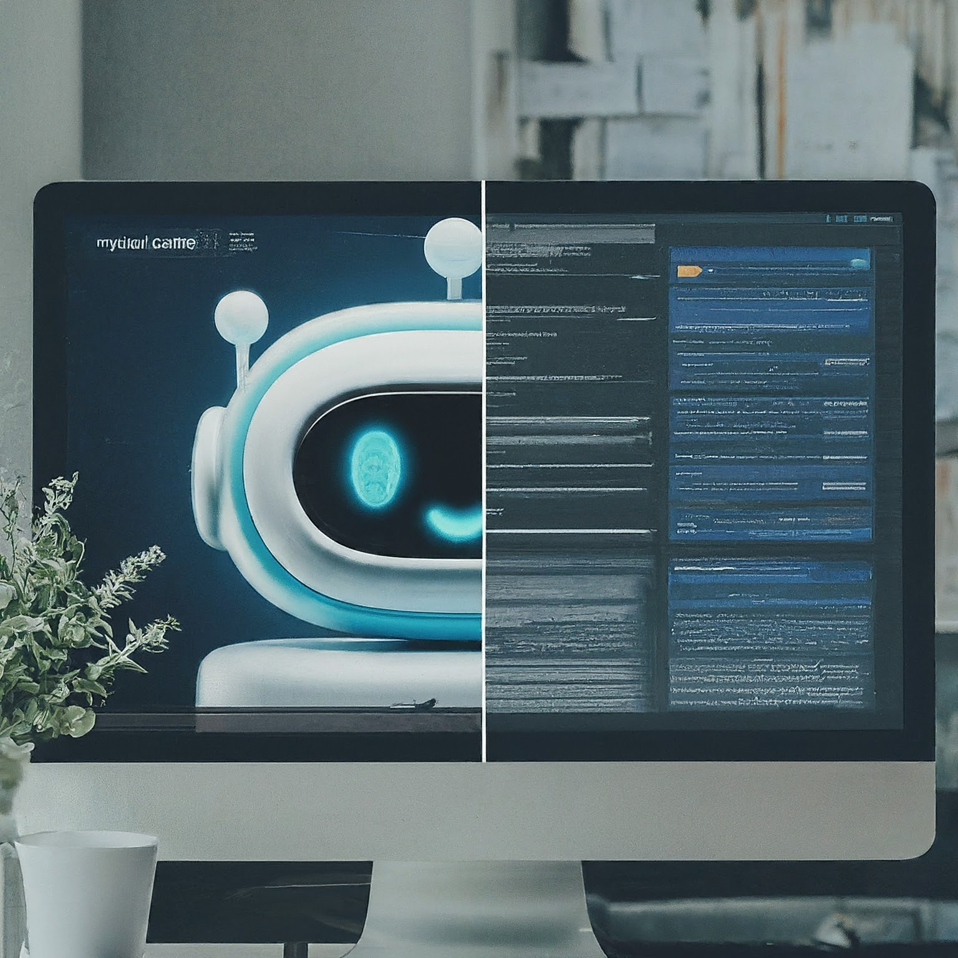
Benefits of our AIML-based System
Improved accessibility to initial medical guidance, especially in remote areas
Reduced risk of human error in diagnosis through AI analysis
Increased efficiency for doctors by allowing them to focus on complex cases
Early detection of potential diseases through AI's ability to identify patterns
Our AIML-based system offers several benefits. It improves accessibility to initial medical guidance, particularly in remote areas with limited access to specialists. The system can reduce the risk of human error in diagnosis by leveraging AI analysis. It can increase efficiency for doctors by allowing them to focus on complex cases while the system handles simpler queries. Additionally, AI's ability to identify patterns can potentially lead to earlier detection of diseases.

Slide 8
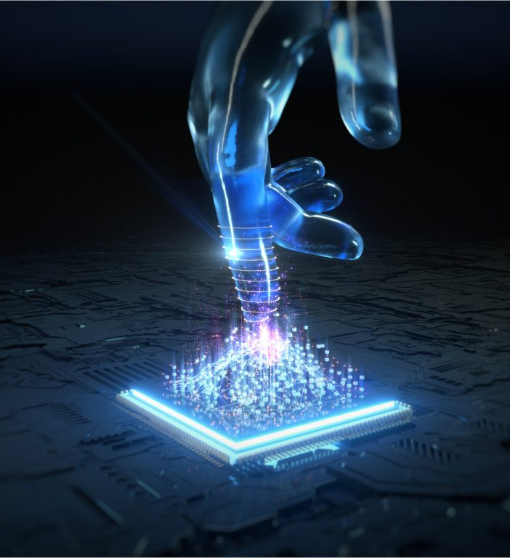
The Future of AI and AIML in Medical Diagnosis
•Continuous development of AI algorithms for improved accuracy
•Integration with medical wearables for real-time health monitoring

Slide 9

Thank you

